Slide 1

Predicting attrition Created by: Denise Dodd
Notes:
Hi, My name is Denise Dodd. In this presentation, I will be taking on the role of an outside consultant who is teaching a company how to use a predictive classification model to predict attrition.

Slide 2
BUSINESS PROBLEM – COST OF ATTRITION
Cost of Time, Money, and Knowledge through the following:
Exit Process
Job Postings
Resume Reviews
Candidate Interviews
Negotiations
Onboarding
Training
Transfer of Duties
Notes:
When an employee leaves a company, there is not only the financial cost of replacing the employee, but the cost of time and knowledge as well.
Listed here are a few examples of the losses that a company must overcome when an employee attrites. These examples include:

Slide 3
SOLUTION
Predict who will attrite and engage in mitigating efforts to prevent attrition.
Select and train a predictive classifier model
Determine what features contribute to attrition
Notes:
One solution to prevent attrition and to avoid the loss of time, money, and knowledge is to:
In this presentation I will show your company how they can achieve this by:

Slide 4
DATA
Anonymous company
Roughly 4,500 employees with 16% attrition rate
Mixture of 24 numeric and categorical variables
The business does not have control over all variables
Notes:
The data that will be used during this study is from
In your study, you will want to replace this with data pertaining specifically to your company.

Slide 5
DATA CLEANING
Differs depending on data set
Review for nulls
Asses spread of variables
Remove unnecessary variables

Slide 6
DATA PREPERATION
Create dummy variables
Assign “Attrition” to be target variable and remaining to be features variable
Separate features and target variables into 80/20 training/testing sets

Slide 7
MODEL SELECTION
Use loop to fit and make predictions on several classification models
Analyze classification report for each model which includes Precision, Recall, F-1, and Accuracy metrics (discussed on next slide)
Determine if hyper-tuning is necessary
Initiate instance of selected model outside of loop
Notes:
Multicollinearity: High correlation between variables such as age and total working years, job level and job role, etc.

Slide 8
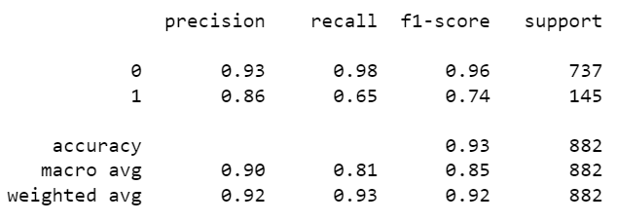
METRICS
Hyper-tuned Decision Tree Classifier:
Notes:
Precision: With a precision score of .93, 93% of the times of the model’s prediction of 0 (no attrition) were also a 0 in the test data. With a precision score of .86, 86% of the instances where the model predicted 1 (yes attrition) were also a 1 in the test set. (True Positives/All Predicted Positives)
Recall: With a recall score of .98, this model correctly identified 98% of no attrition instances. With a recall score of .65 this model accurately identified 65% yes attrition instances. (Correctly Predicted Positives/Actual Positives in Test Set)
F1-Score: The F1-Score is an average of the precision and recall scores.
Accuracy: With an accuracy score of .93, 93% of this model's predictions are correct.

Slide 9
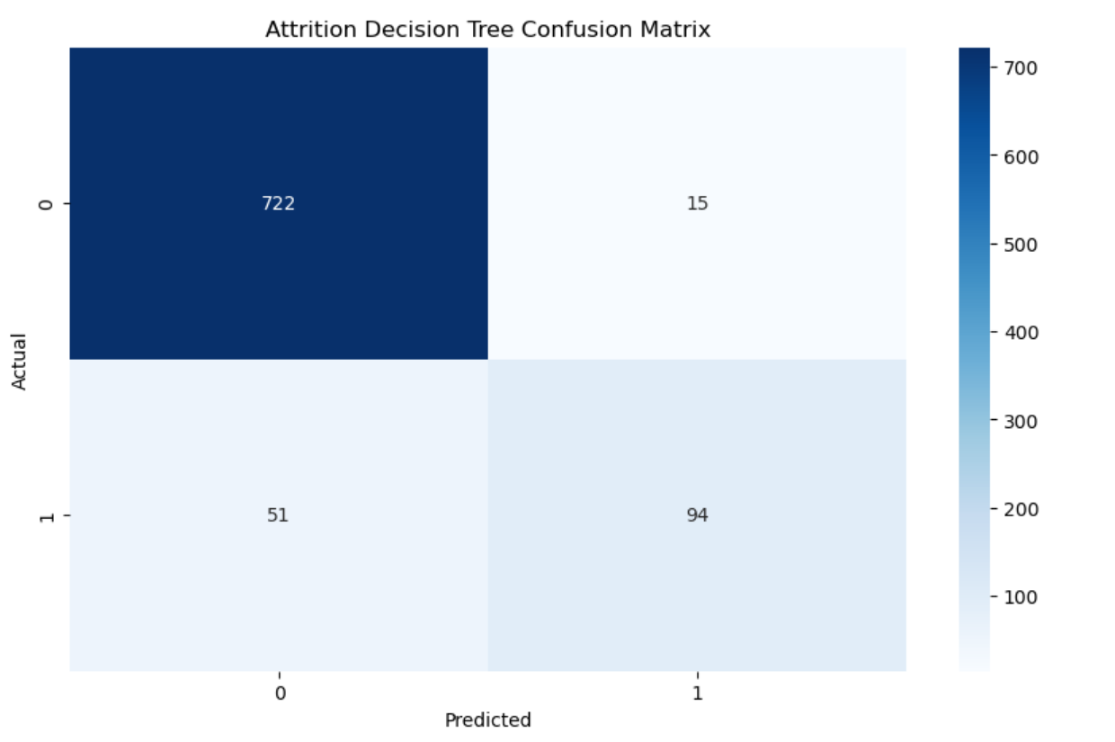
CONFUSION MATRIX
Notes:
Visualizations to convey how model works and efficiency of model to executives.
This confusion matrix shows that the Decision Tree classified:
722 of the employees who did not attrite correctly. (TP)
15 of the employees who did not attrite incorrectly (FP)
51 of the employees who did attrite incorrectly (FN)
94 of the employees who did attrite correctly (TN)

Slide 10
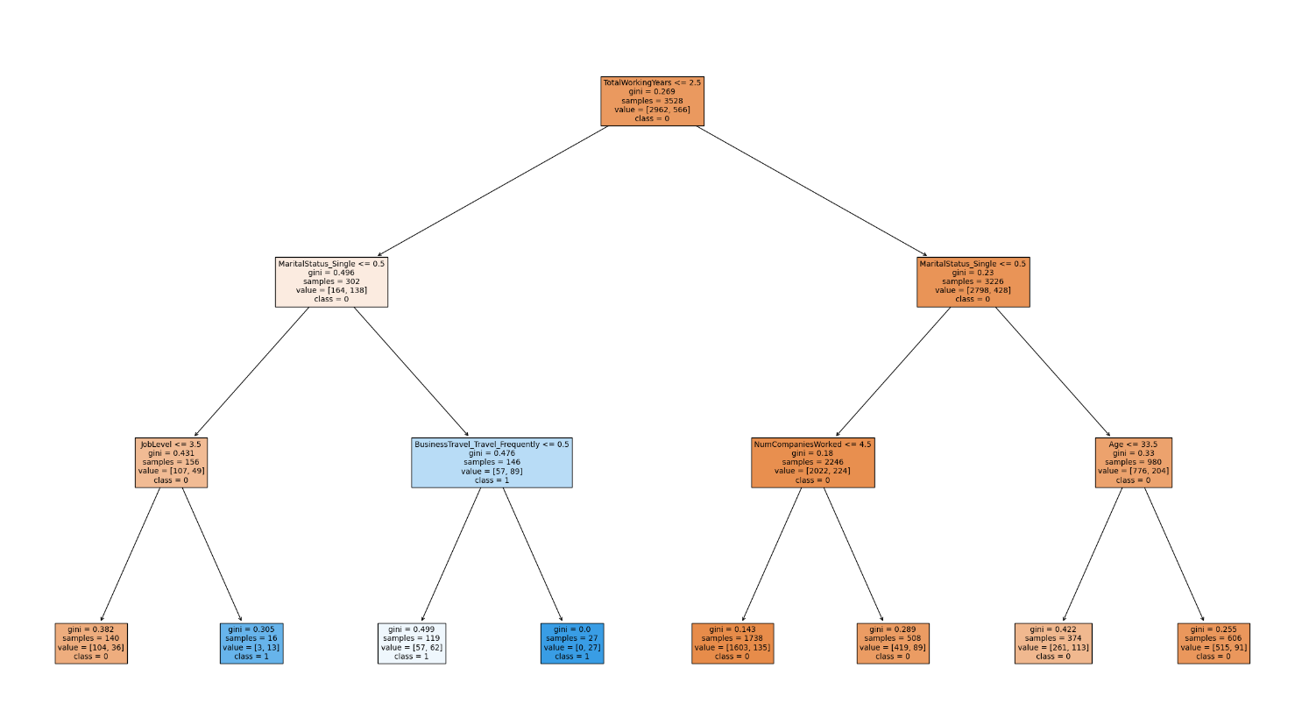
DECISION TREE PLOT
Notes:
The below tree is a visualization of the behind-the-scenes reasoning that occurs when the Decision Tree deploys its model. The hyper-tuned Decision Tree has a depth of 10 which results in multiple branches and nodes that clutter the visualization. Therefore, I have trained a model with a depth of 3 to provide an example of the logic a decision tree performs to complete its classification. Here you can see how the model groups the data and separates into branches.

Slide 11
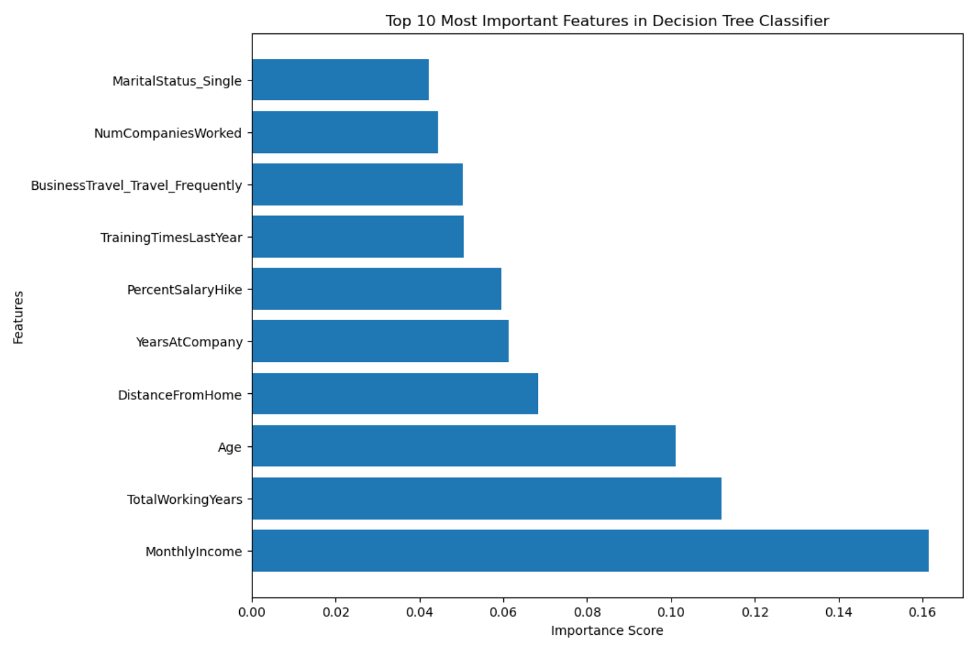
FEATURES IMPORTANCE
Notes:
Discuss variables that the company can and cannot control.

Slide 12
CONSIDERATIONS
All of the findings in this study pertain only to this sample dataset.
When your company runs this exercise, you might have different variables that impact your specific company such as location, shift time, etc.
From an ethical perspective, be conscious of what variables you use and how you act upon the importance of the variable to your model.

Slide 13
RECOMMENDATIONS
Factors the business can control in Top 10 Important Features:
Monthly Income/Price Salary Hike
Distance From Home
Training Times Last Year
Frequent Business Travel
Notes:
MonthlyIncome/PriceSalaryHike – These variables both pertain to the associate’s salary. It is recommended the company conducts an industry analysis to determine if their compensation structure matches industry standards.
DistanceFromHome – The company cannot dictate where an employee lives, but they can offer options such as remote work, hybrid work, or a satellite office.
TrainingTimesLastYear – Offer an optional mentorship program. This will allow employees overwhelmed with training to opt out and employees seeking additional training and guidance the opportunity to learn more about their job and the industry from a more experienced coworker.
BusinessTravel_Travel_Frequently – Modern technology allows for many meetings to be done virtually via a video conferencing system. Depending on the field of business, it is possible that this will not eliminate all business travel, but it can lessen the amount from “Frequently” to “Rarely.”

Slide 14
IMPLEMENTATION
Cost Analysis
Budgeting
Benchmark

Slide 15
QUESTIONS
Addressed in supplemental documentation.

Slide 16
RESOURCES
Brownlee, J. (2023, October 10). How to use ROC curves and precision-recall curves for classification in Python. MachineLearningMastery.com. https://machinelearningmastery.com/roc-curves-and-precision-recall-curves-for-classification-in-python/
Kaggle. (2022, November 3). Employee attrition. Kaggle. https://www.kaggle.com/datasets/ajayganga/employee-attrition
Kanstren, T. (2023, August 4). A look at precision, recall, and F1-score. Medium. https://towardsdatascience.com/a-look-at-precision-recall-and-f1-score-36b5fd0dd3ec
Steen, D. (2020, September 20). Precision-recall curves. Medium. https://medium.com/@douglaspsteen/precision-recall-curves-d32e5b290248
Wallace, L. (2023, March 21). Forbes EQ Brand Voice: Five hidden costs of employee attrition. Forbes. https://www.forbes.com/sites/forbeseq/2023/03/21/five-hidden-costs-of-employee-attrition/?sh=482ecd3562f4

Slide 17
THANK YOU
Denise Dodd
555-555-5555
denise@predictiveconsulting.com
www.predictiveconsulting.com

